Slide 1
Distributor Business Analytics
By Gopalakrishnan Kumar, MTech IIT-Bombay,
Freelance Data Science Consultant
LinkedIn: Profile Link : https://www.linkedin.com/in/gopalakrishnankumar-a73301110/
Github:https://github.com/Gopal21236/
Kaggle URL- https://www.kaggle.com/gopalkk2

Slide 2
Google Colab URL
https://colab.research.google.com/drive/13MXW7ivCpToaG4DmTQRAO6tXRgWWEBEp?usp=sharing

Slide 3
Introduction
Mutual fund distributors play a critical role in asset mobilization, client acquisition, and long-term wealth creation. Evaluating distributor performance using data analytics enables asset management companies and advisory firms to identify top performers, optimize commission structures, and design growth strategies.
This project focuses on Distributor Business Analytics, leveraging Python to analyze Assets Under Management (AUM), asset-class distribution, and business productivity using advanced visualizations.

Slide 4
Objectives of the Project
The key objectives of this project are:
To analyze distributor-wise Assets Under Management (AUM)
To study AUM distribution patterns across distributors
To evaluate business concentration and diversification
To visualize performance using analytical charts
To support strategic distributor management decisions

Slide 5
Dataset Description
The dataset is simulated to represent real-world distributor business data. It includes:
Distributor Name
Equity AUM (₹ Lakhs)
Debt AUM (₹ Lakhs)
Hybrid AUM (₹ Lakhs)
Other Asset AUM (₹ Lakhs)
The combined AUM reflects the overall business volume handled by each distributor.

Slide 6
Business Metrics Analyzed
The following business indicators are evaluated:
Total AUM – Scale of distributor business
Asset-Class Mix – Equity, Debt, Hybrid, and Other products
Diversification Level – Risk concentration assessment
Performance Segmentation – High, medium, and low performers

Slide 7
Role of Visualization in Distributor Analytics
Visualization converts complex numerical data into intuitive business insights. Charts allow stakeholders to:
Compare distributors quickly
Identify growth and risk patterns
Monitor business concentration
Make data-driven strategic decisions

Slide 8
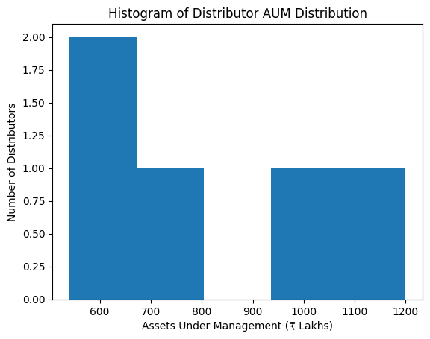
Data Visualization

Slide 9
Visualizations and Analytical Interpretation
6.1 Histogram – Distributor AUM Distribution
Purpose:
To analyze how distributors are distributed across different AUM ranges.
Insights:
Majority of distributors fall in the mid-AUM range
Few distributors manage very high AUM, indicating elite performers
Helps identify underperforming segments
Business Value:
Supports benchmarking and targeted distributor development programs.

Slide 10
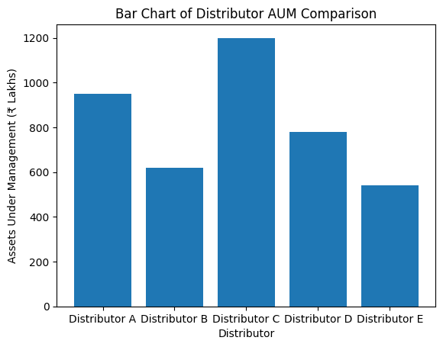
Data Visualization

Slide 11
Visualizations and Analytical Interpretation
6.2 Bar Chart – Distributor AUM Comparison
Purpose:
To compare total AUM across distributors.
Insights:
Highlights top and bottom performers clearly
Makes performance gaps visually obvious
Business Value:
Useful for commission planning, incentive allocation, and performance reviews.

Slide 12
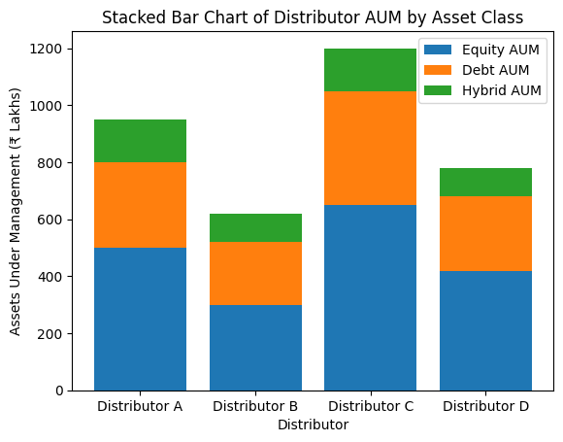
Data Visualization

Slide 13
Visualizations and Analytical Interpretation
6.3 Stacked Bar Chart – AUM by Asset Class
Purpose:
To visualize distributor-wise asset-class diversification.
Insights:
Equity-heavy distributors may carry higher risk exposure
Balanced asset mix reflects stable business quality
Helps assess distributor product strategy
Business Value:
Supports diversification assessment and cross-selling opportunities.

Slide 14
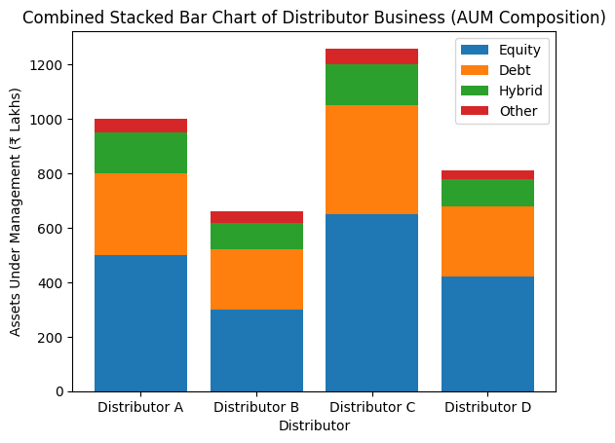
Data Visualization

Slide 15
Visualizations and Analytical Interpretation
6.4 Combined Stacked Bar Chart – Distributor Business Overview
Purpose:
To provide a consolidated view of total AUM and asset-class composition.
Structure:
X-axis: Distributors
Y-axis: Total AUM (₹ Lakhs)
Stacks: Equity, Debt, Hybrid, Other
Key Observations:
Distributor C dominates total AUM with strong equity exposure
Distributor A maintains balanced diversification
Distributor B shows lower scale, indicating growth potential
Distributor D reflects moderate and stable business

Slide 16
Key Business Insights
High-AUM distributors are critical revenue drivers
Asset-class concentration highlights potential risk exposure
Balanced portfolios indicate long-term sustainability
Mid-tier distributors present the strongest growth opportunity

Slide 17
Business Impact
This analytics framework enables:
Improved distributor performance monitoring
Better incentive and commission structuring
Strategic product focus decisions
Risk management through diversification analysis
Scalable distributor management systems

Slide 18
Learning Outcomes
Through this project, learners gain:
Understanding of distributor business dynamics
Practical exposure to financial analytics
Data visualization expertise using Python
Ability to convert data into actionable insights
Real-world mutual fund distribution analysis skills

Slide 19
Conclusion
Project 1D demonstrates how data analytics and visualization can effectively evaluate distributor performance and business composition. The combined stacked bar chart offers a powerful summary of scale and diversification, making it an essential tool for business reviews and strategic planning.
This project closely aligns with real-world asset management and wealth distribution analytics.

Slide 20
Future Enhancements
Time-series AUM growth analysis
Client acquisition vs AUM productivity analysis
Commission and revenue forecasting
Power BI or Tableau dashboard integration
Automated distributor performance alerts

